Slide 1
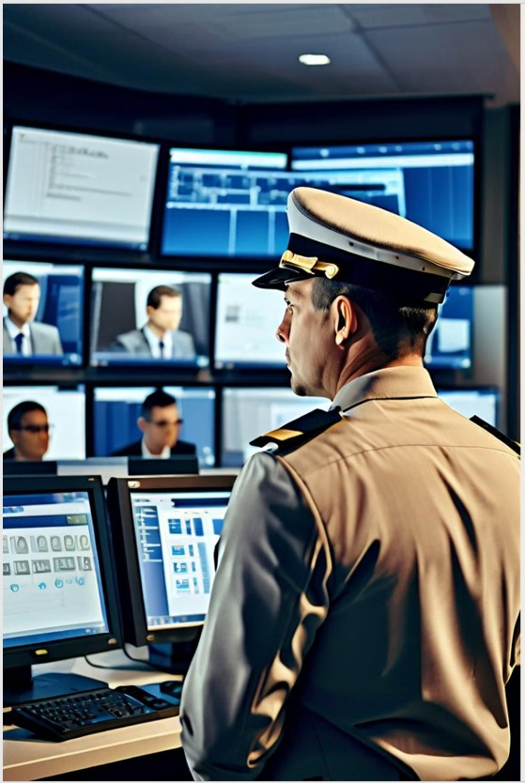

High-Alert
Capstone Project Phase 2
Security Guard Unawareness Detection System
Supervisor: Dr. Rauven Cohen
Mrs. Aliza Atally
Students:
Yohan Leykin
Haim Hadad

Slide 2

Agenda
Problem
Solution
Demo
Challenges
Results

Slide 3

Problem

Slide 4
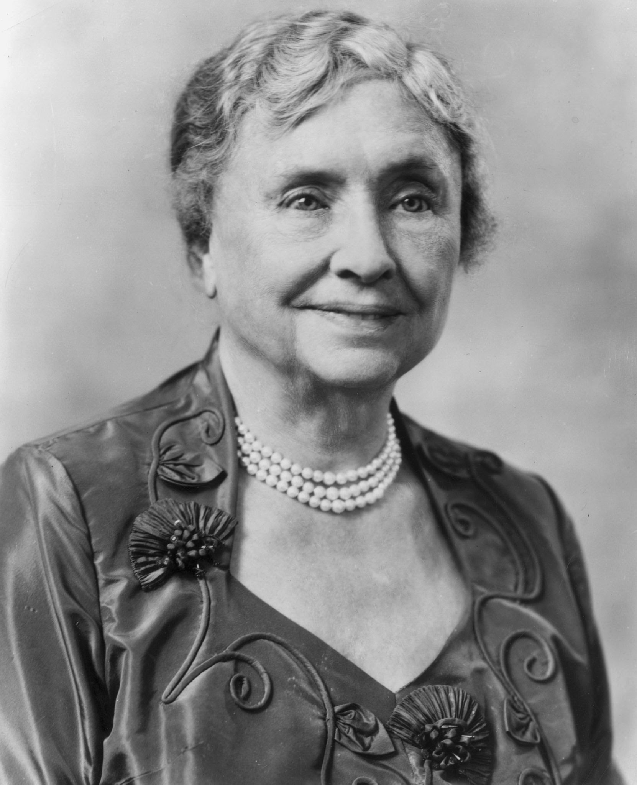
"God himself is not secure, having given man dominion over his work”
Helen Keller

Slide 5
Problem
Security guards ensure safety in public spaces.
Incidents like theft, and violence can happen if guards are unaware.
Unaware guards may lead to property loss or injuries.

Slide 6
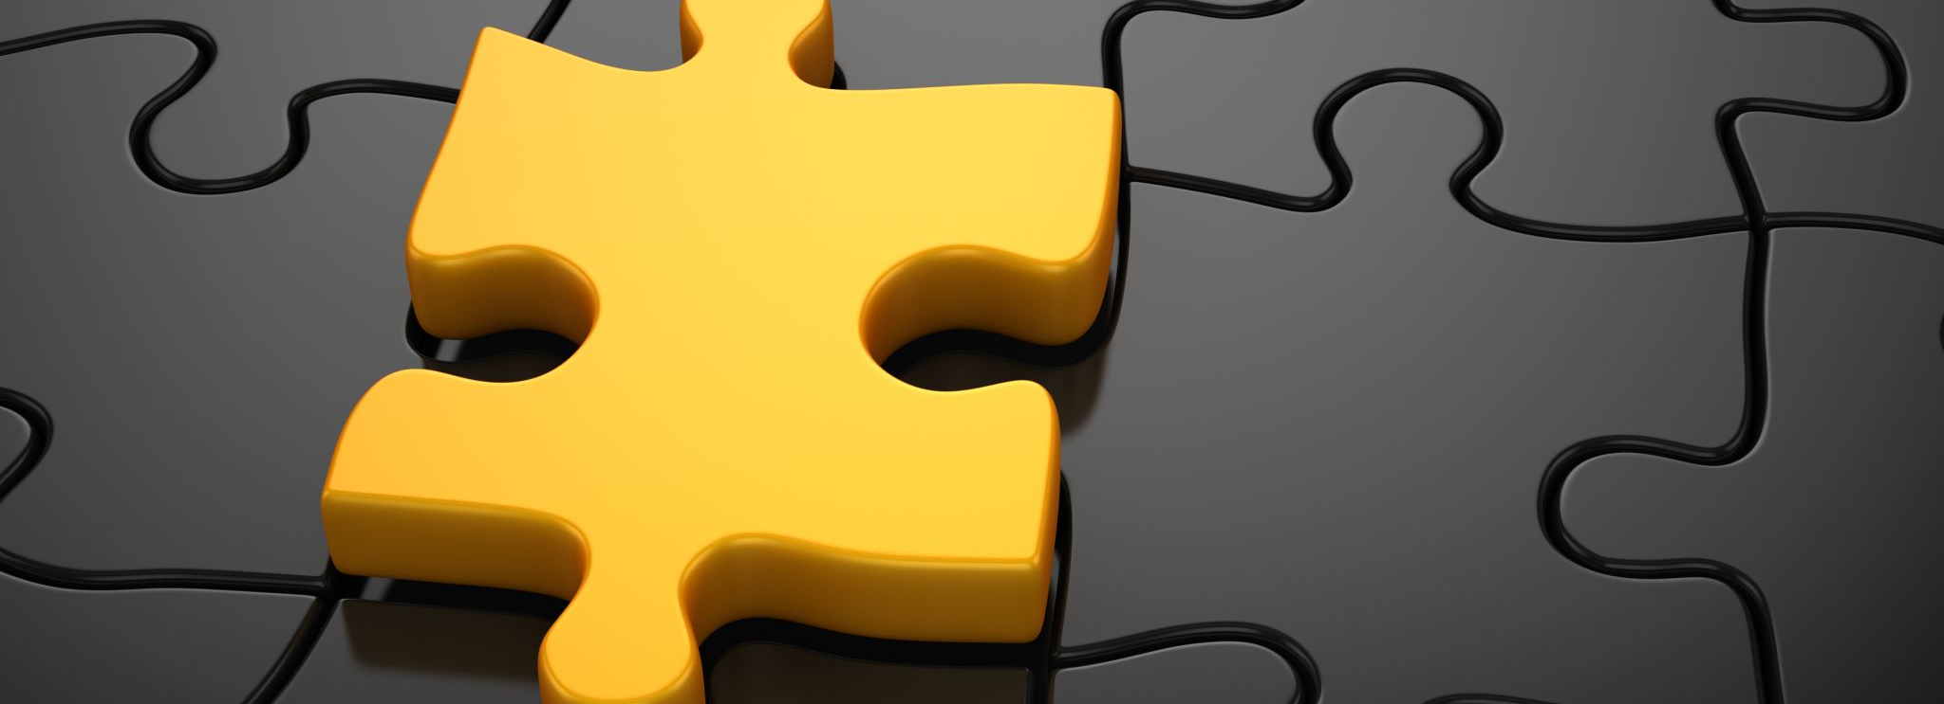
Solution

Slide 7
High-Alert
Academic project proposes using Computer Vision to analyze security guard behavior and facial expressions.
System predicts awareness levels of guards.
If unawareness is detected, the system notifies.

Slide 8
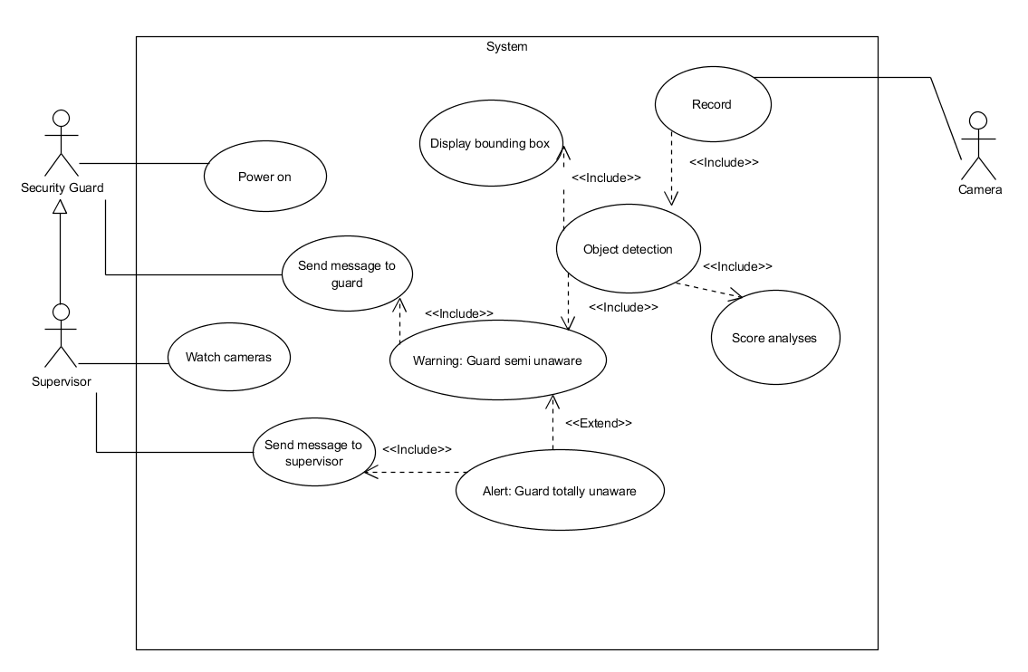
Usecase Diagram

Slide 9




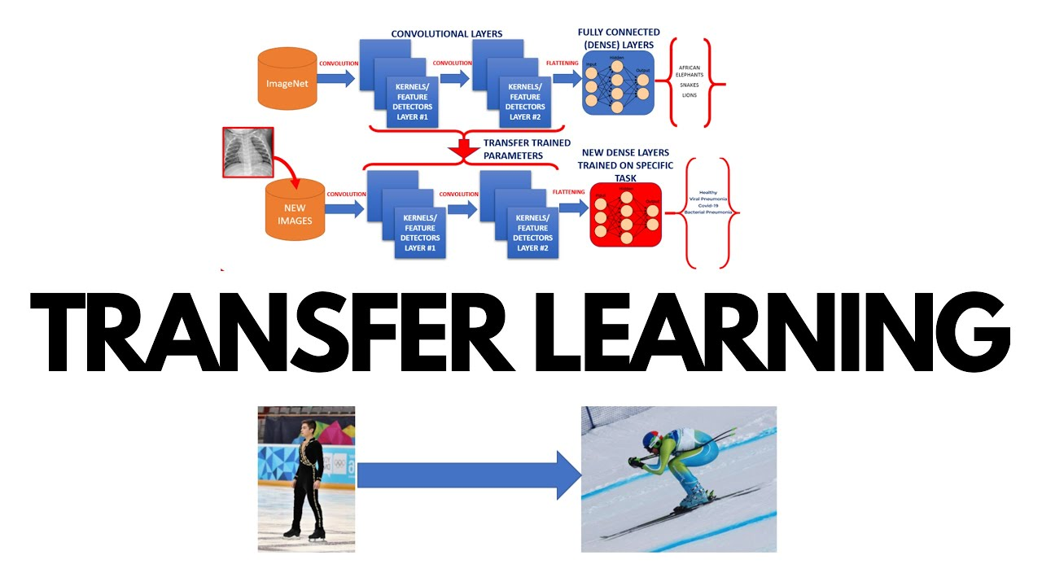
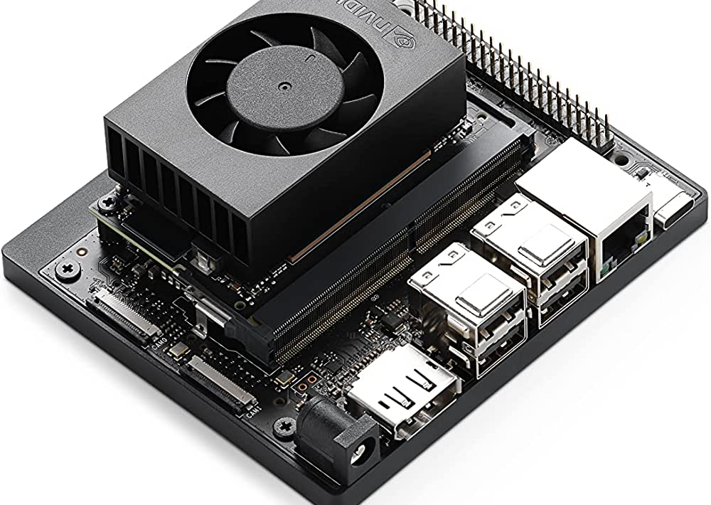
Technologies
Python
PyQt5
OpenCV
YoloV7
Transfer Learning
Nvidia Jetson

Slide 10
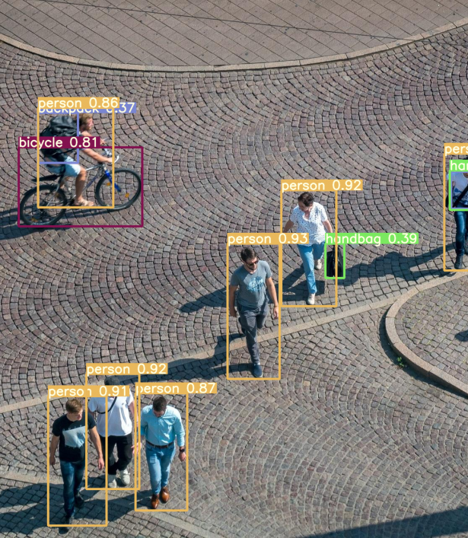
Software
YoloV7 Algorithm
YOLO (You Only Look Once) is an object detection model.
It's designed to identify and locate objects within an image or video frame.
Unlike traditional methods, YOLO considers the entire image at once to make predictions.
It's known for its speed and efficiency, making it suitable for real-time applications.
YOLO provides bounding boxes around detected objects along with class labels and confidence scores.
Notes:
בולטים
YOLOV7

Slide 11
Hardware
Nvidia Jetson Board
NVIDIA Jetson: Small, low-power embedded computing device.
Designed for AI and machine learning applications.
Powered by ARM processor and NVIDIA's Maxwell GPU architecture.
Offers high-performance computing for edge devices and embedded systems.

Slide 12
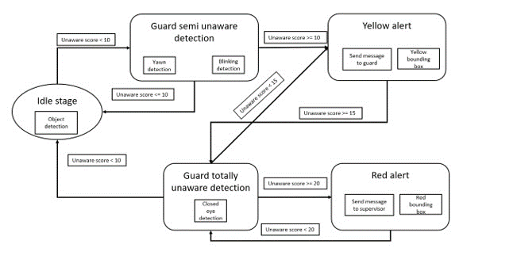
High-Alert
1 minute time frame for calculation within 5 minutes total time frame

Slide 13
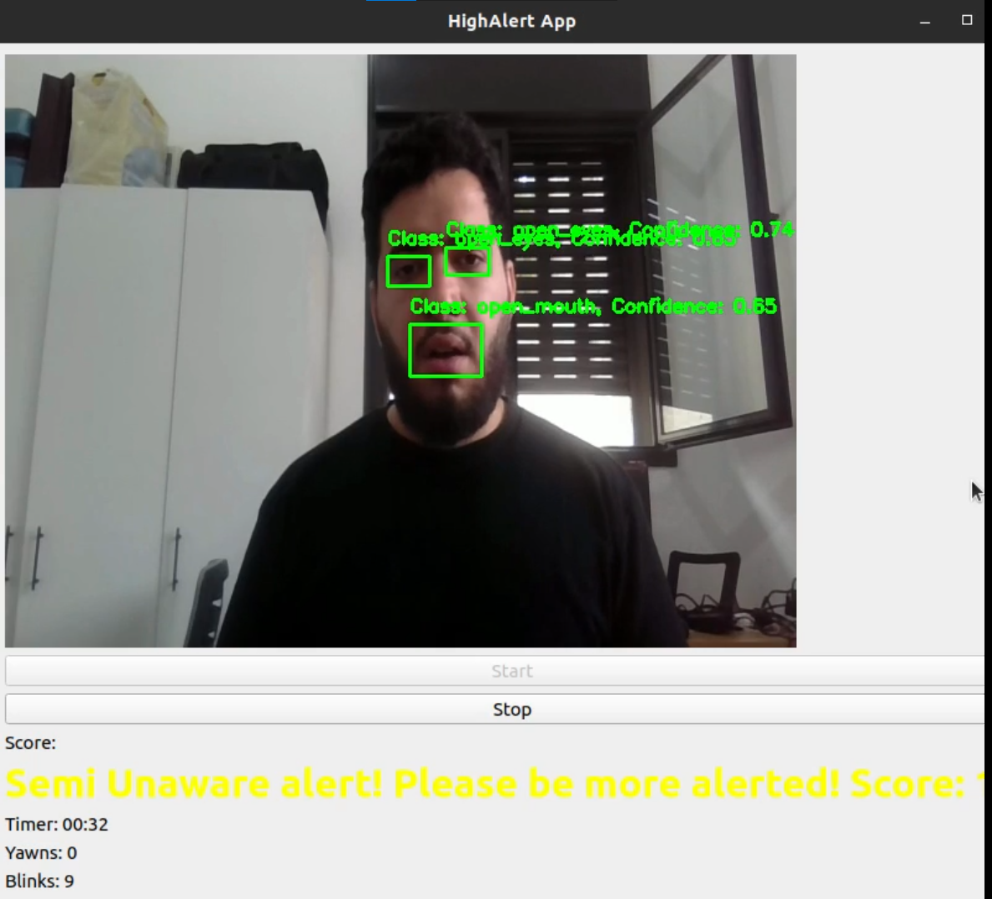
High-Alert

Slide 14
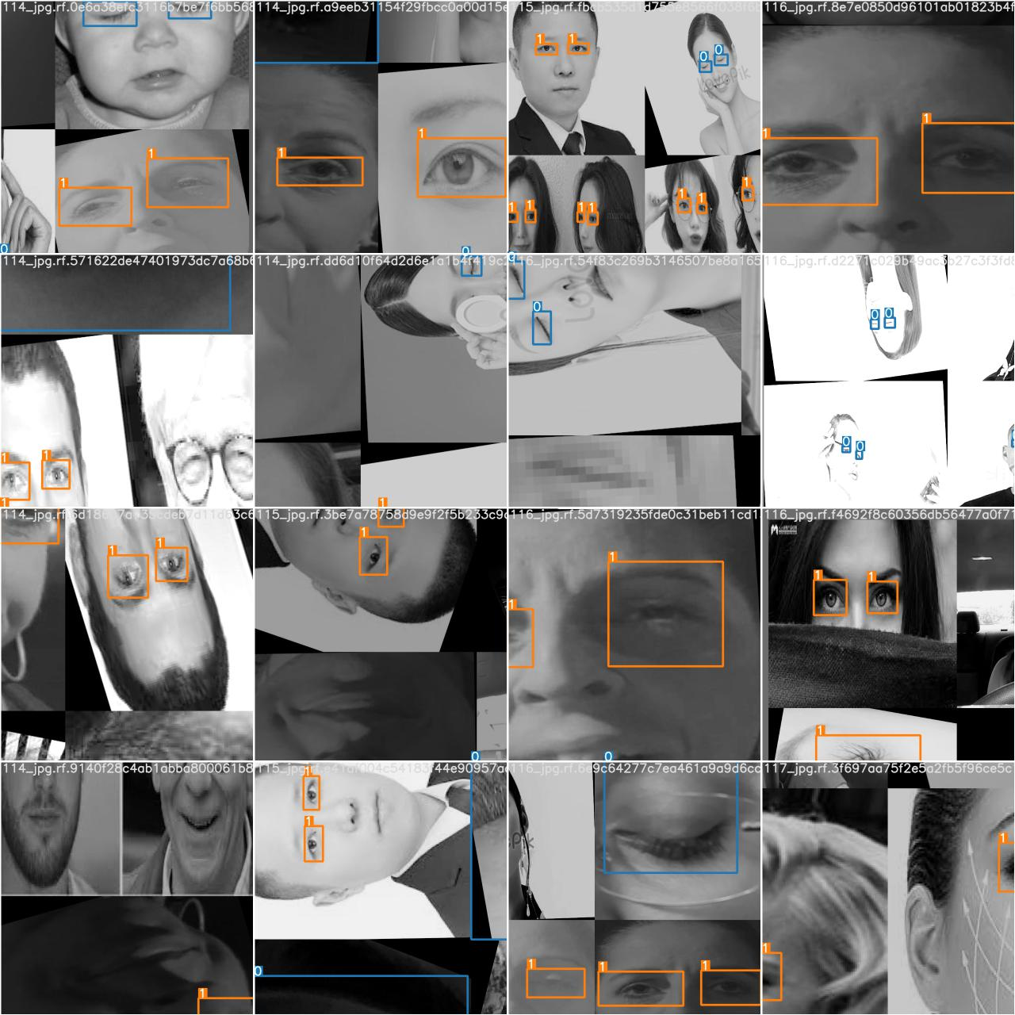
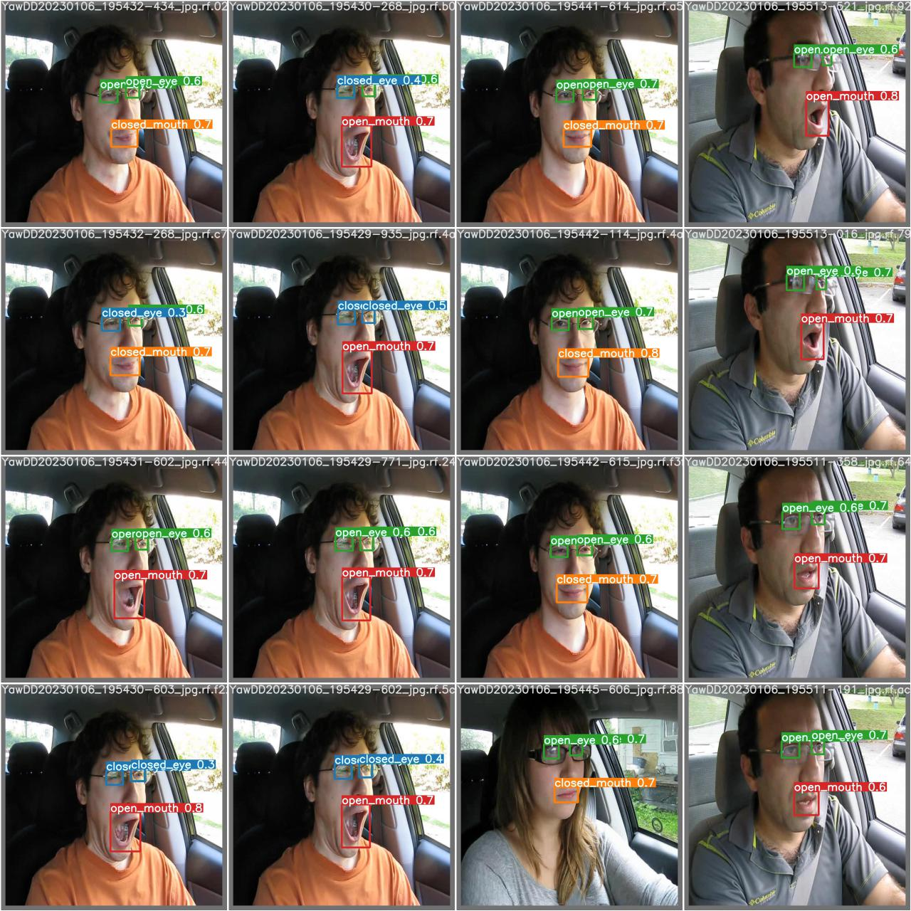
Challenges
Visualization
Dataset
Camera and face angels
Video footage
Notes:
נוסיף משפט

Slide 15
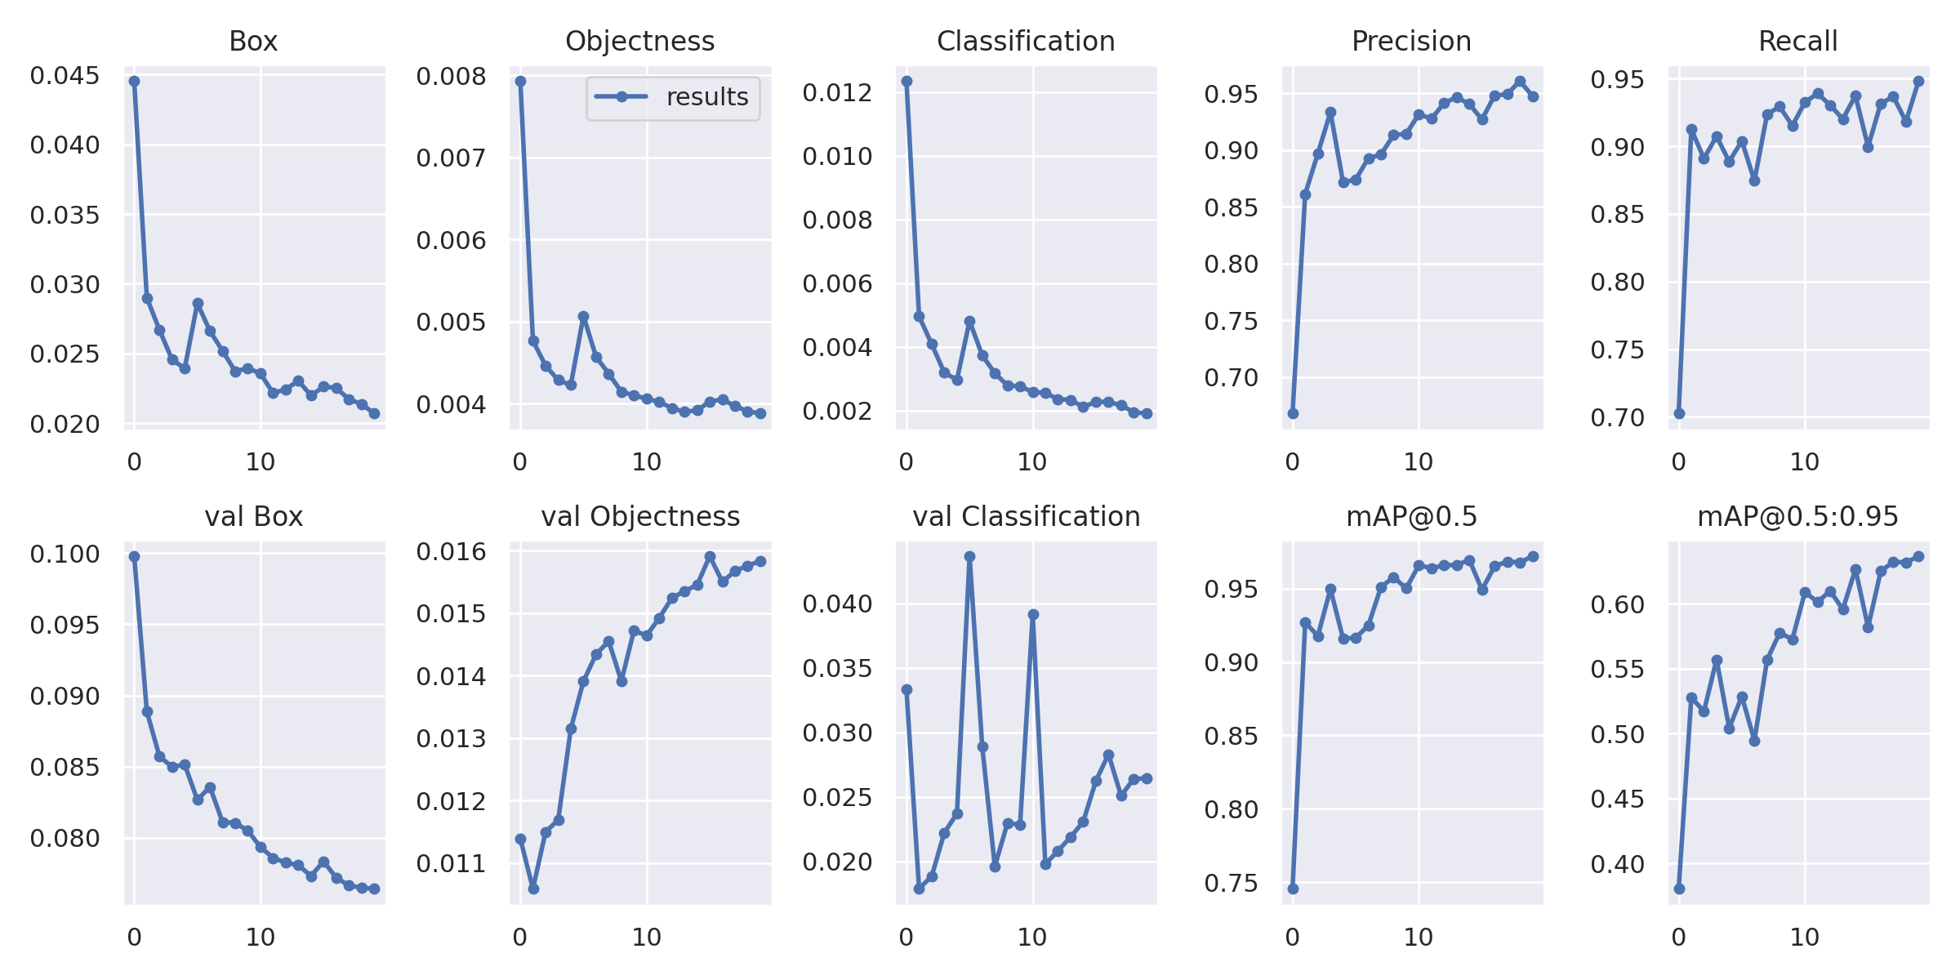
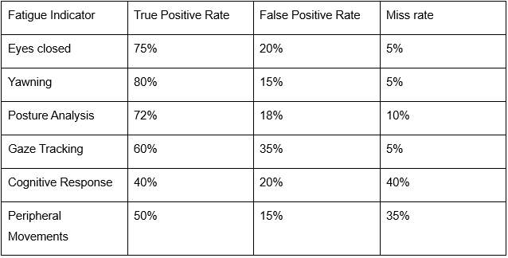
Results
We can now detect blinks and yawns accurately within a 1-1.5 meter range, achieving a 70%
accuracy rate in both real-time and video feeds of security guard footage on 20 videos footages.
The Driver Fatigue dataset we used gave us on driver footage around 95% accuracy. The dataset includes 9834 train images and 204 test images.

Slide 16
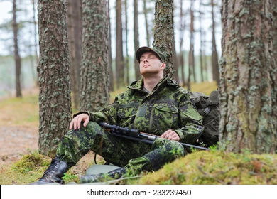
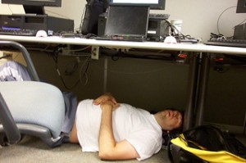
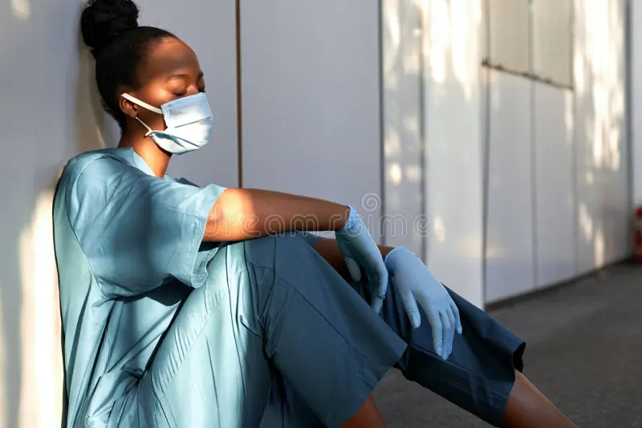

Suggested Implementation

Slide 17

Q&A

Slide 18

Thank You!

